Slide 1


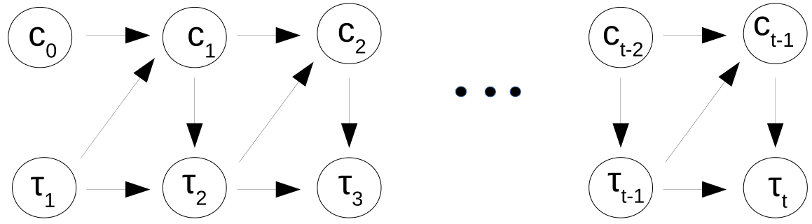
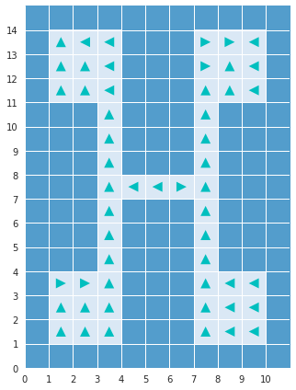
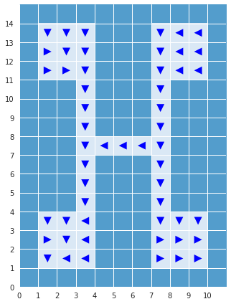
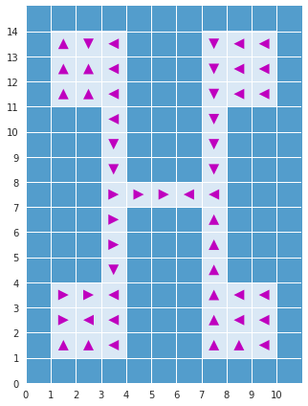
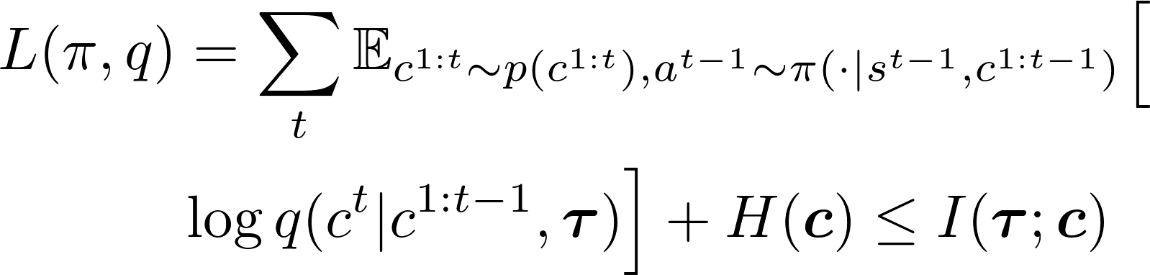
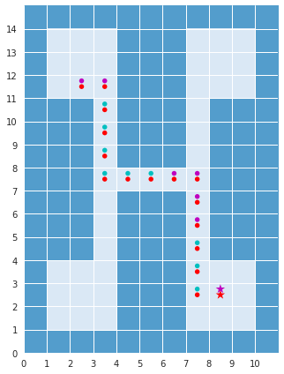
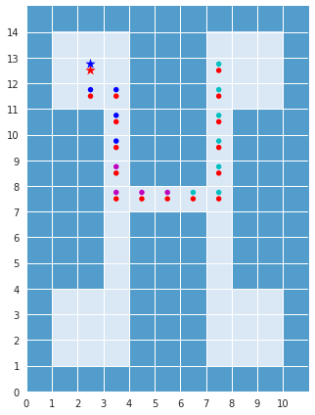
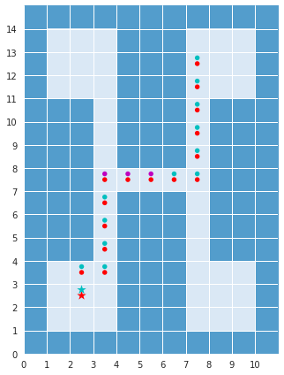

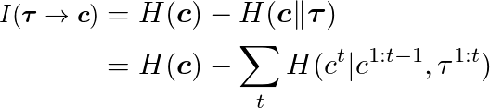
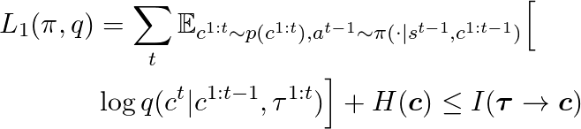
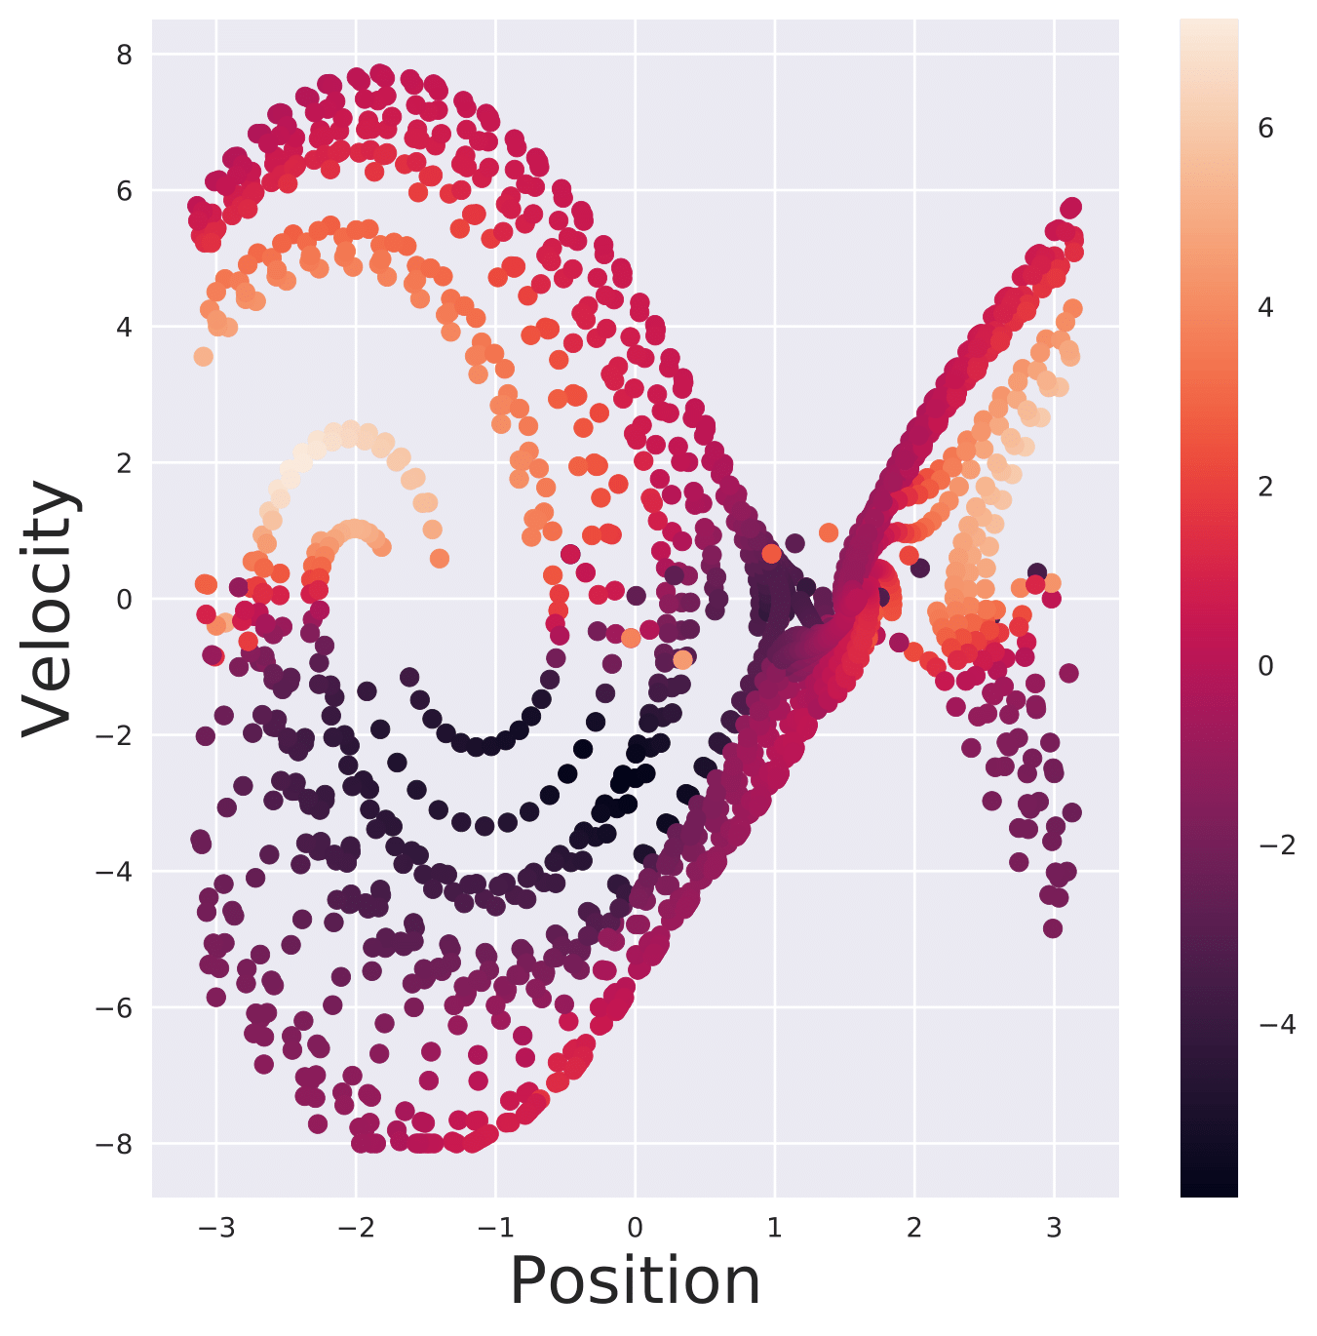
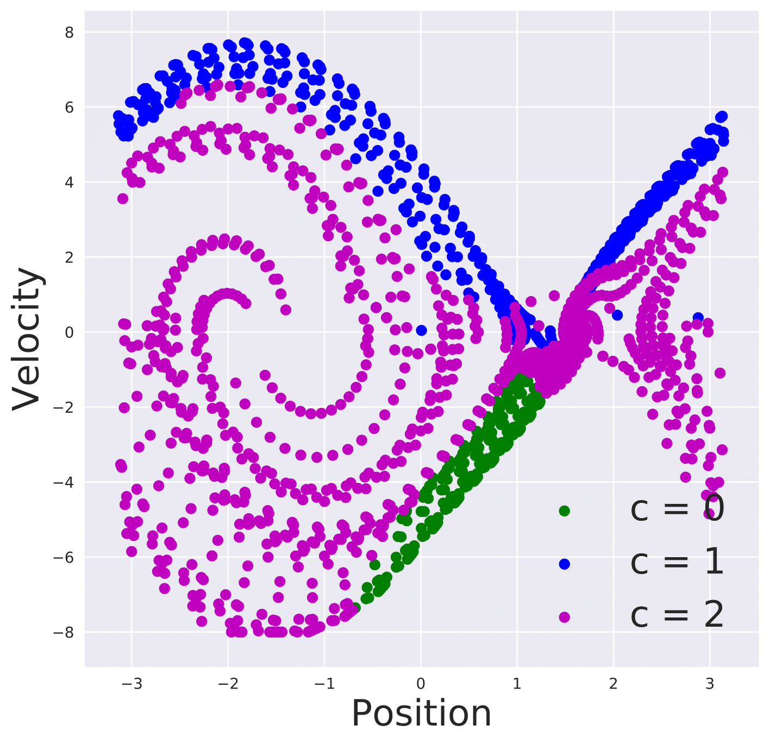
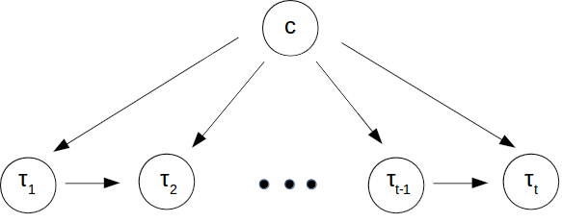
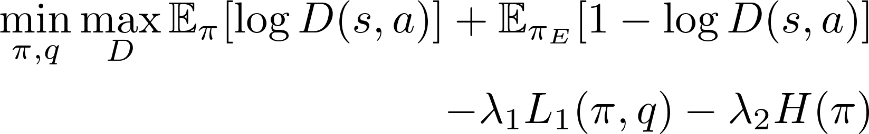
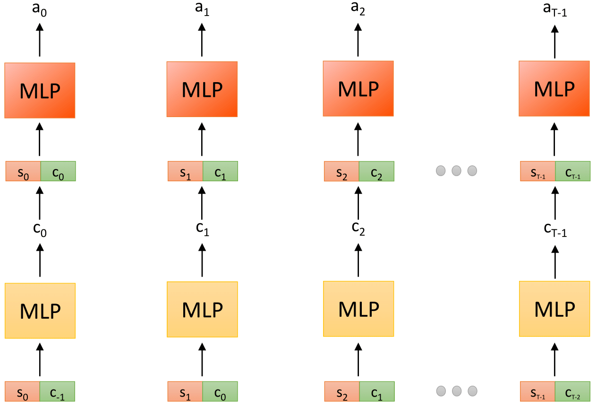




Learning Hierarchical Policies from Unsegmented Demonstrations using Causal Information
Mohit Sharma*, Arjun Sharma*, Nicholas Rhinehart, Kris M. Kitani
Introduction
Learning complex tasks require learning sub-task specific policies.
In this work, use a Directed Graphical Model to learn the interaction between sub-tasks and resulting state-action trajectory sequences
Our algorithm CausalInfo-GAIL learns sub-task policies from unsegmented demonstrations by maximizing the directed information flow in the resulting graphical model.
We also show how our approach connects with existing `Options' framework commonly used to learn hierarchical policies
Method
Experiments
Discrete environment
15x11 grid with 4 rooms connected via corridors. An object is placed at the center of a random room at the beginning of the episode. The agent spawns at a random location in the grid.
Figure 2: Graphical model used in this work
Using lower bound to mutual information,
Causal Information
Using lower bound to causal information,
where L₁ is the lower bound to causal information.
Variational Auto-encoder (VAE) pre-training
Dependence of q on the entire trajectory precludes its use at test time where only trajectory up to current time is known
Imitation Learning
Generative Adversarial Imitation Learning (GAIL) [1]
Objective,
GAIL for mixture of experts [2, 3]
c : Latent variable denoting expert
Maximize lower bound to mutual information,
Overall objective,
Figure 3: Visualization of sub-policy actions (top) and macro-policy actions (bottom)
Continuous environments
Using causal information removes dependence of q on future unobserved trajectory. Thus, q can now be used as a macro-policy to select the next sub-task latent variable.
Overall Causal-Info GAIL objective,
Figure 1: Graphical model in [2, 3]
Figure 4: Visualization of sub-policy actions (left) and macro-policy actions (right) on Pendulum-v0
Environment | GAIL | VAE | Causal-Info GAIL
Pendulum | -121.4 ± 94.1 | -142.9 ± 95.6 | -125.4 ± 103.8
Inverted Pendulum | 1000.0 ± 15.2 | 218.8 ± 8.0 | 1000.0 ± 15.0
Table 1: Returns over 300 episodes on continuous environments
Options framework
Learn approximate prior over latent variables using VAE
References
[1] J. Ho and S. Ermon. “Generative Adversarial Imitation Learning." NIPS, 2016.
[2] Y. Li, J. Song and S. Ermon. “InfoGAIL: Interpretable Imitation Learning from Visual Demonstrations." NIPS, 2017.
[3] K. Hausman, Y. Chebotar, S. Schaal, G. Sukhatme and J. J. Lim. ‘‘Multi-modal Imitation Learning from Unstructured Demonstrations using Generative Adversarial Nets.’’ NIPS, 2017.
[4] C. Daniel, H. V. Hoof, J. Peters and G. Neumann. “Probabilistic Inference for determining Options.” Machine Learning, 2016.
[5] R. Sutton, D. Precup and S. P. Singh. “Intra-option learning about temporally abstract actions.” ICML, 1998
[6] J. Massey. “Causality, Feedback and Directed Information.” ISITA, 1990
Option:
Sub-policy:
Termination policy:
Option activation policy:
* - Equal contribution

